Slide 1
Ocitocina e TEA: from bench to bedside
Profa. Dra. Miriam Ribeiro
Universidade Presbiteriana Mackenzie
Notes:
A ocitocina significa parto rápido, do grego. Foi o primeiro peptídeo a ter sua estrutura quimica identificada e sinteizada no laboratorio dando o premio nobel para Vincent du Vigneaud in 1955. No fim dos anos 70 estudos farmacológicos mostraram que a OT apresenta papel importante na coordenaçao do comportamento maternal necessario para o sucesso da reproduçao no sentido de sobrevivencia da espécie.

Slide 2
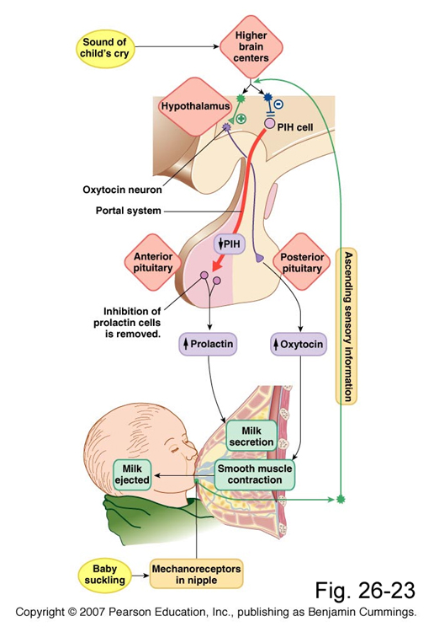

Slide 3
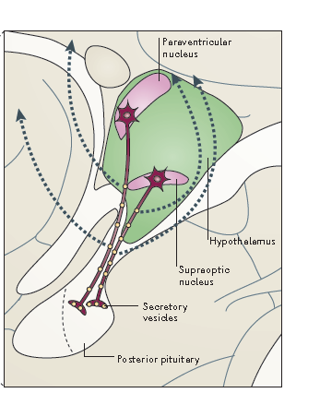
Núcleo Paraventricular (NPV) e Supraótico (NSO)

Slide 4
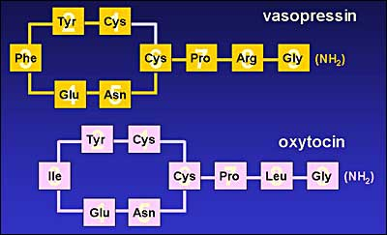
Ocitocina

Slide 5
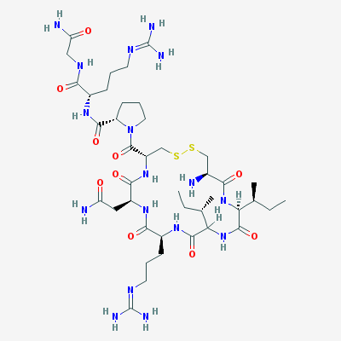
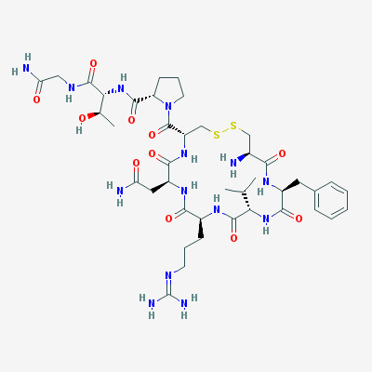
Conopressina Anetocina
Gastrópodos
Anelídeos

Slide 6
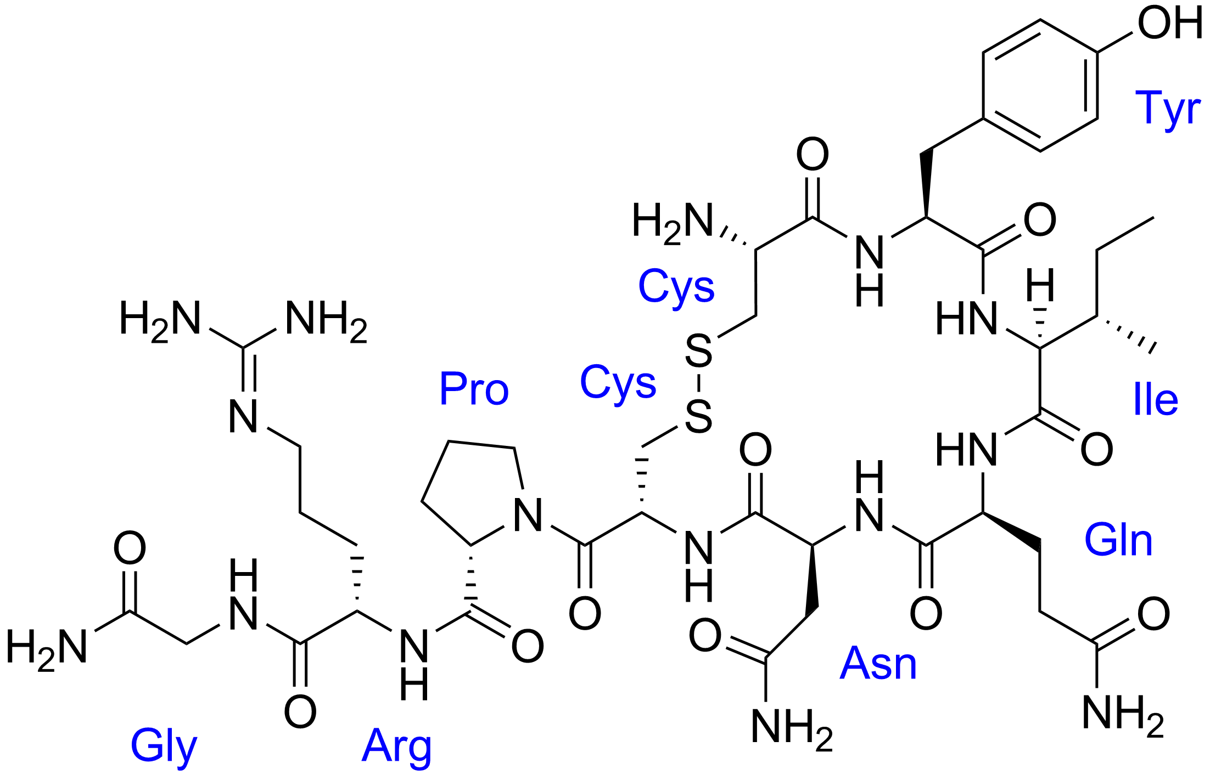
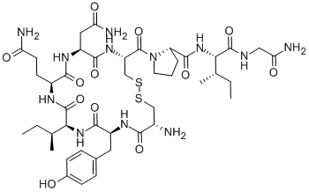
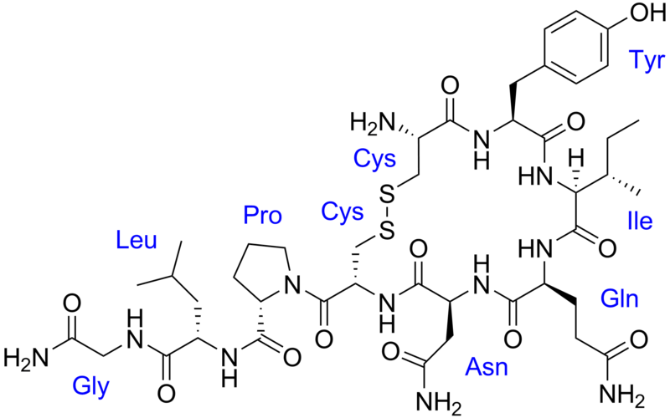
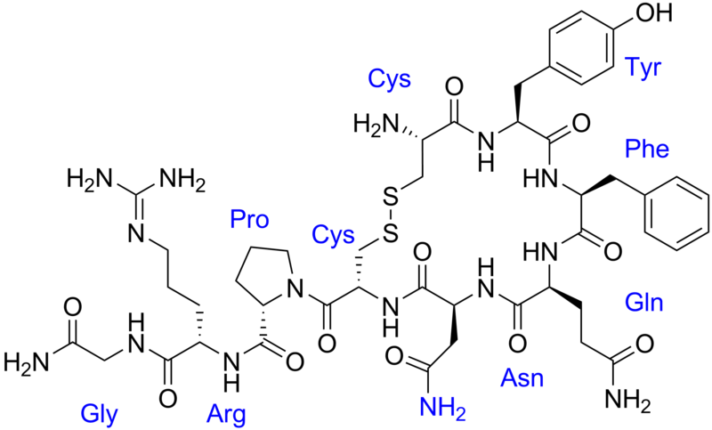
mesotocin
vasotocin
Peixes, aves e anfíbios: territorialista
Peixes, aves e anfíbios: gregário
vasopressin
oxytocin
Notes:
Vasotocina: ocorre em peixes, aves e anfíbios e induz comportamente territorialista
Mesotocina: ocorre em aves, peixes e anfíbios e induz comportamento gregário

Slide 7
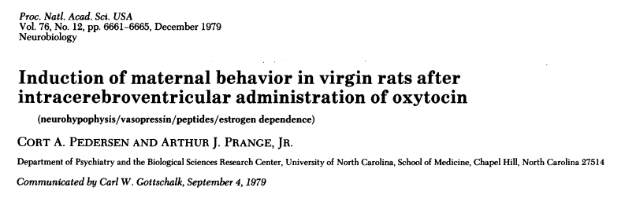
Ocitocina e comportamento maternal
Notes:
Ratas e ratos exibem comportamento maternal após o contato com filhotes postiços por 5 a 7 dias. Todos os hormônios envolvidos foram testados individualmente e o que se encontrou foi o estrógeno como mais intense.
Ratas virgens apresentam indiferença ou ate mesmo aversão aversao a filhotes da mesma espécie. Injeçao de oxitocina no ventriculo cerebral induz ao comportamento maternal em ratas virgens. A OT parece ter papel importante no início do cuidado materno, nao sendo necessaria uma vez estabelecida o cuidado com filhotes.

Slide 8
Notes:
Sexually mature, virgin female Sprague-Dawley rats (250-350 g) were obtained from the Zivic Miller Laboratory (Allison Park, PA). Pregnant females timed to deliver at regular intervals were obtained from the same source to ensure a supply of pups. Indwelling cannulae were placed in the left lateral intracerebral ventricle of each virgin female under light ketamine anesthesia (100 mg/kg intraperitoneally).
Grouping, licking, crouching, retrieval and nest building.

Slide 9
Inibição da Ocitocina
Inibição da ocitocina farmacologicamente inibe o comportamento maternal em ratas recém-paridas.
  Witt and Insel. Endocrinology 1991.
  Leengoed e cols. J of Endocrinology, 1987

Slide 10
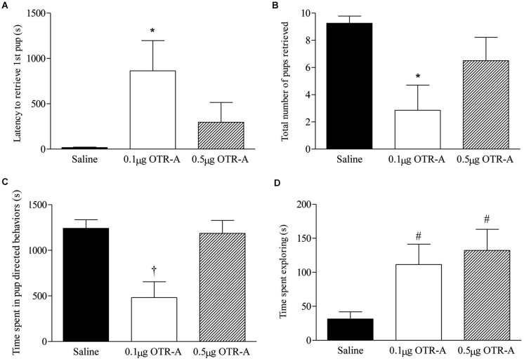
Blocking OTR in the postpartum mPFC impairs maternal behavior
Notes:
Blocking OTR in the postpartum mPFC impairs maternal behavior. Postpartum females receiving the lower 0.1 μg/μl dose of the OTR-A in the mPFC took longer to retrieve the first pup (A) and retrieved fewer pups (B) as compared to saline controls. The lower dose of the OTR-A in the mPFC also decreased the amount of time spent in pup directed behaviors (C). Both the low and high dose of OTR-A increased home cage exploratory behavior (D). Bars represent mean ± SEM; * P < 0.05 0.1 μg/μl OTR-A vs. saline, † P < 0.05 0.1 μg/μl OTR-A vs. saline and 0.5 μg/μl OTR-A, # P < 0.05 0.1 μg/μl OTR-A and 0.5 μg/μl OTR-A vs. saline.

Slide 11
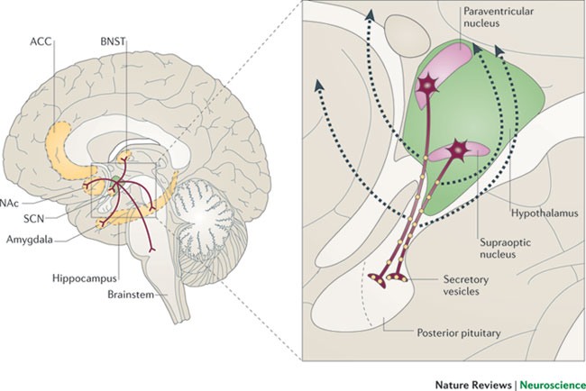
Liberação de ocitocina
Notes:
Nas – núcleos accumbens
ACC – Comissura anterior
BNST – stria terminal

Slide 12
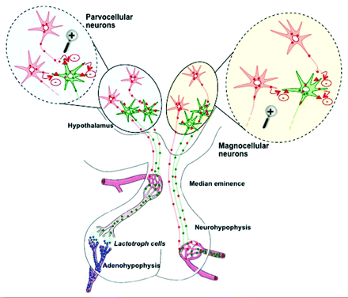

Slide 13
Distribuição dos receptores OTR
In rodents: olfactory bulb (OB) and tubercle, neocortex, endopiriform cortex, hippocampal formation, central and lateral amygdala, BNST, nucleus accumbens (NAcc), and ventromedial hypothalamus (VMH) (Insel et al., 1991; Veinante and Freund-Mercier, 1997).
In humans: basal nucleus of Meynert, the nucleus of the vertical limb of the diagonal band of Broca, the ventral part of the lateral septal nucleus, the preoptic/anterior hypothalamic area, the posterior hypothalamic area, the substantia nigra pars compacta, and the substantia gelatinosae of the caudal spinal trigeminal nucleus and of the dorsal horn of the upper spinal cord, as well as in the medio-dorsal region of the nucleus of the solitary tract (Loup et al., 1991; Loup et al., 1989).

Slide 14
Gênero específico
OT and OTR expression is usually higher in females (Carter, 2007; Zingg and Laporte,2003).
The central roles of OT on behaviors and physiology are strongly dependent on steroid hormones and gender.
OT and OTR distributions between brains of different sexes have been reported (Carter, 2007; Insel et al., 1991; Tribollet et al., 1997; Tribollet et al., 1992).

Slide 15
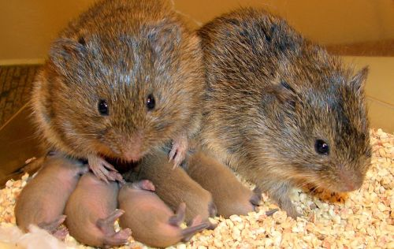
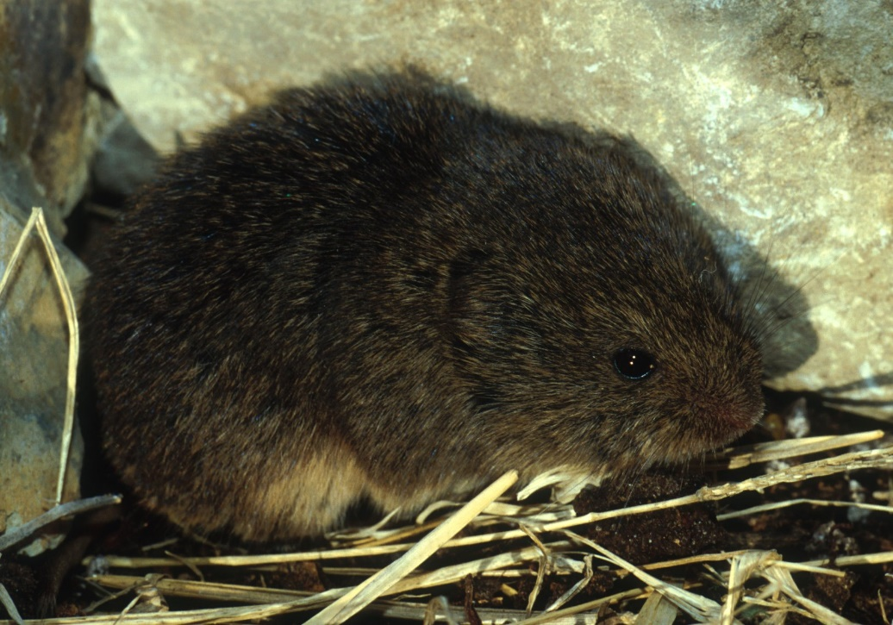
Comportamento parental e monogamia
Rato do campo (Microtus ochrogaster)
Rato da montanha (Microtus montanus)
Notes:
Some male prairie voles are devoted fathers and faithful partners, while others are less satisfactory on both counts. The spectrum of behavior is shaped by a genetic mechanism that allows for quick evolutionary changes, two researchers from Emory University report in today’s issue of Science.
The manipulation of a single gene is enough to cure the wandering eye of a meadow vole. According to a report published today in the journal Nature, gene therapy that increases levels of a specific protein in the brain turned the promiscuous creatures into monogamous mates.”

Slide 16
Notes:
A, C e E – rato da pradaria
B, D e F – rato da montanha
A – Rato da pradaria
B- rato da montanha
D – rato do pinheiro
E rato do brejo

Slide 17
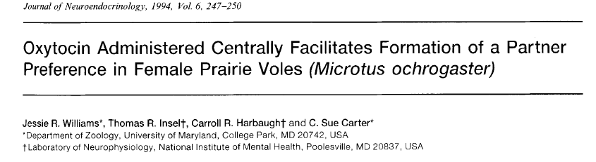
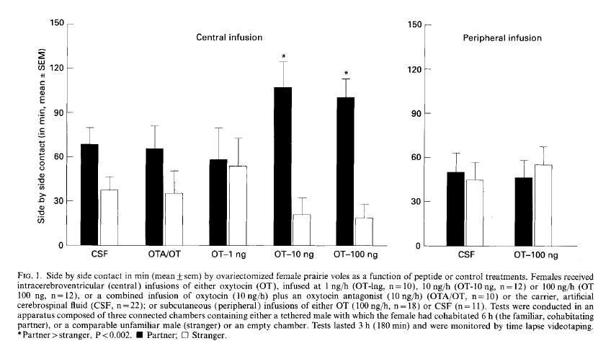
Notes:
Para que a preferência se estabeleça é preciso a interação sexual. Caso não haja comportamento sexual demora 24 horas para que se estabeleça a preferência. Com a ocitocina isso demora minutos.
Portanto, infere-se que o acasalamento estimula a liberação de ocitocina que age no sistema límbico levando à formação de casais.

Slide 18
Comportamento aloparental

Slide 19
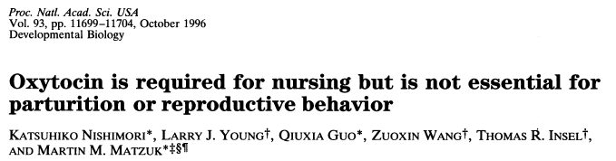
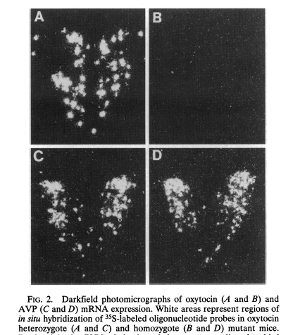
Hibridização in situ de ocitocina
Ht
Hz
Ht
Hz
Hibridização in situ de vasopressina
Notes:
O primeiro modelo de camundongos com knockouts para a ocitocina mostraram que as mães Hz não são capazes de amamentar, mas apresentam comportamento maternal normal. Isso poderia ser explicado pelo fato dos camundongos exibirem comportamento maternal expontaneo, diferentemente das ratas.

Slide 20
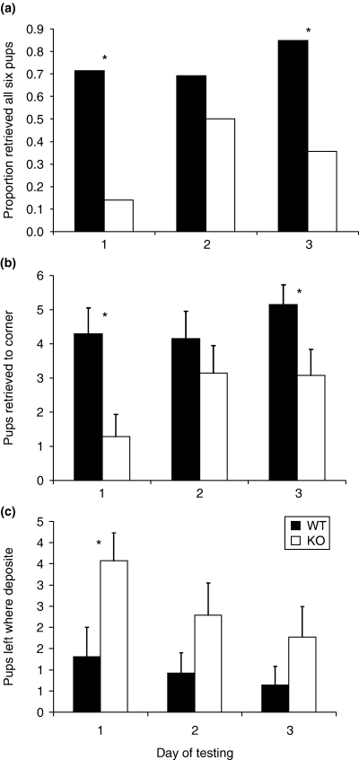
Maternal behavior deficits in nulliparous oxytocin knockout mice
Genes, Brain and Behavior
Volume 5, Issue 3, pages 274-281, 8 JUL 2005
http://onlinelibrary.wiley.com/doi/10.1111/j.1601-183X.2005.00162.x/full#f1

Slide 21
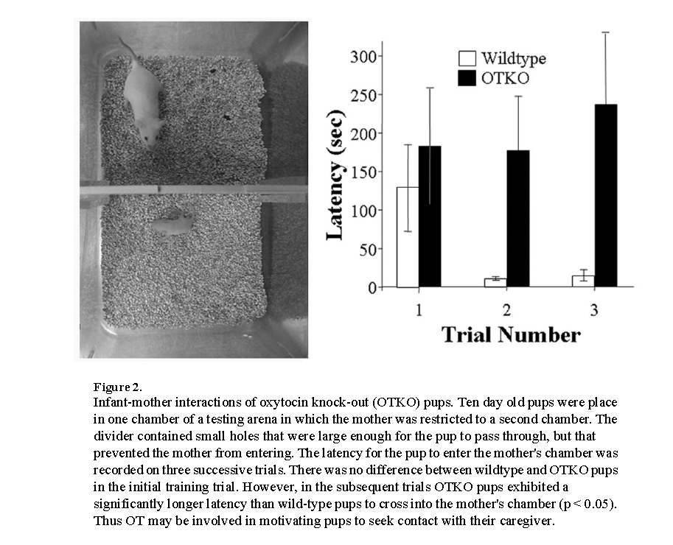
Interação do filhote com a mãe
Notes:
Infant-mother interactions of oxytocin knock-out (OTKO) pups. Ten day old pups were place in one chamber of a testing arena in which the mother was restricted to a second chamber. The divider contained small holes that were large enough for the pup to pass through, but that prevented the mother from entering. The latency for the pup to enter the mother's chamber was recorded on three successive trials. There was no difference between wildtype and OTKO pups in the initial training trial. However, in the subsequent trials OTKO pups exhibited a significantly longer latency than wild-type pups to cross into the mother's chamber (p < 0.05). Thus OT may be involved in motivating pups to seek contact with their caregiver

Slide 22
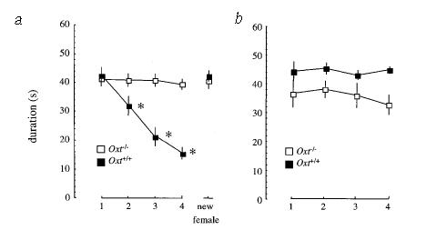
Reconhecimento social
Notes:
Fig. 1 Social memory in mice. a, Social memory by Oxt–/– (open symbols) and Oxt+/+ (filled symbols) male mice was measured as a difference in olfactory investigation. Data depict mean +/–1 s.e.m. for the amount of time (s) allocated to investigation of the same ovariectomized (OVX) female
during each of four successive 1-min trials. A fifth ‘dishabituation’ trial depicts the response of males to the presentation of a new female in a 1-min pairing 10 min after the fourth trial. Asterisks represent a significant decrease between each trial compared with the first trial for Oxt+/+ males
(measured with Newman-Keuls (q) comparisons; second, q=4.11; third, q=8.15; fourth trial, q=10.4, P<0.05). b, Depiction of olfactory investigation when a different OVX stimulus female is presented in each repeated trial. Stimulus females were rotated between successive males so that
new males in each of four trials investigated each female. The persistence of social investigation by males in these tests indicates that changes in female behaviour associated with repeated encounters with males do not account for the decline in male interest when meeting the same female in repeated trials. c, Depiction of olfactory investigation of the same OVX stimulus presented in each of two 5-min trials with an intertrial interval of 30 min. Oxt–/– mice showed no significant reduction of olfactory investigation in the second meeting with a stimulus female, whereas Oxt+/+
mice showed an approximately 70% reduction (q=3.2, P <0.05). d, Depiction of significant differences in olfactory investigation by Oxt–/– (open symbols) and Oxt+/+ (filled symbols) mice of intact male (squares; effect of genotype: F(1,104)=17.9, P<0.05) or intact female (circles; effect of genotype:
F(1,56)=16.9, P< 0.05) stimulus mice during each of four successive 1-min trials.

Slide 23
Reconhecimento social em humanos
Estudos correlacionais dos níveis periféricos de OT
Utilização de spray nasal.

Slide 24
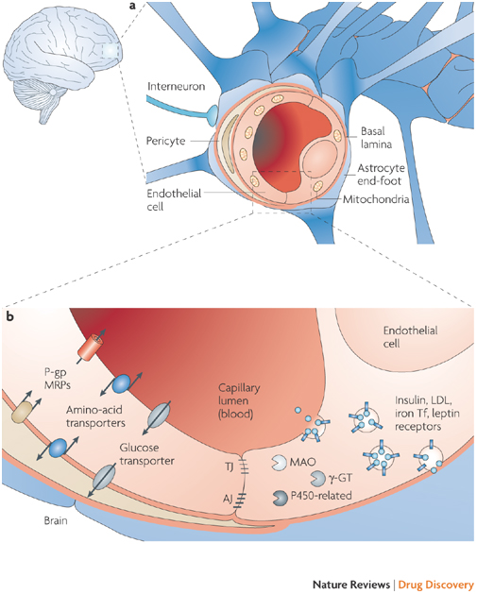

Slide 25
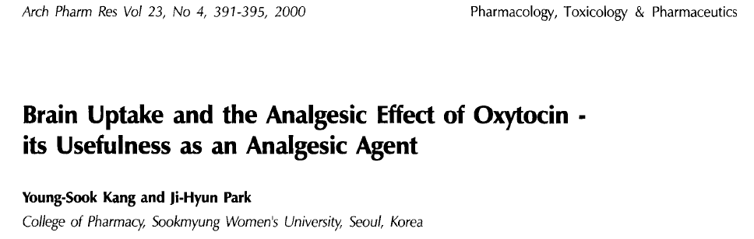
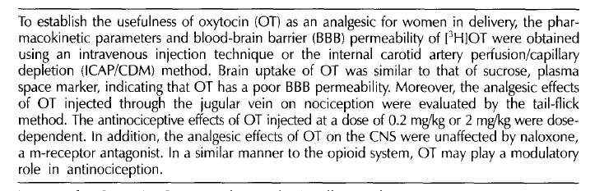

Slide 26
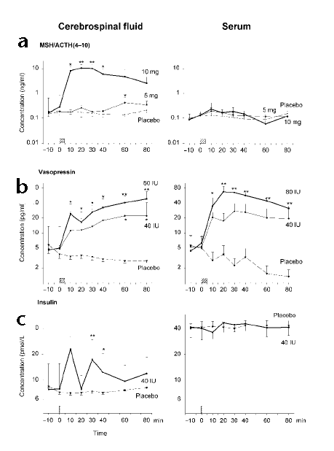


Slide 27
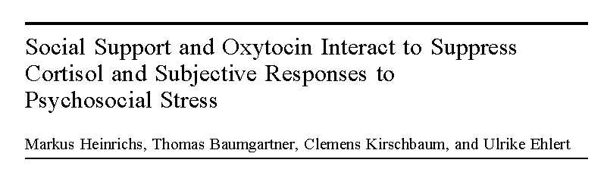
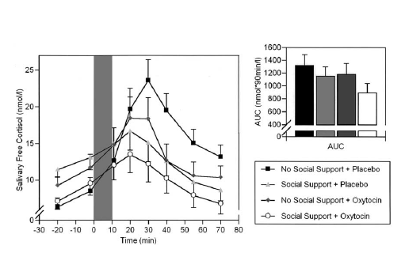

Stress social
Notes:
Esse foi o primeiro estudo mostrando o papel da ocitocina como ansiolítico. O stress ativa o eixo hipotálamo-hipófise-adrenal, elevando a produçao de cortisol, o principal componente endócrino para adaptaçao ao stress. Adultos saudáveis receberam ocitocina intranasal e foram submetidos ao teste de trier social stress test. Esse estudo mostra que a ocitocina modula o stress da interação social.

Slide 28

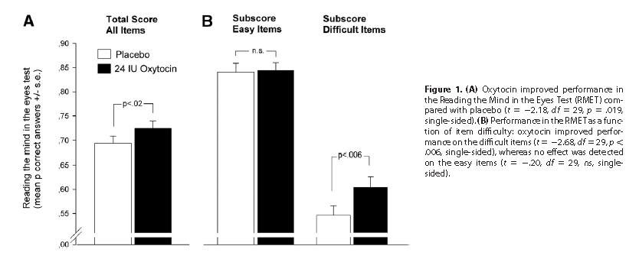

Slide 29
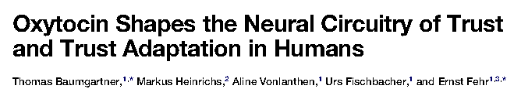
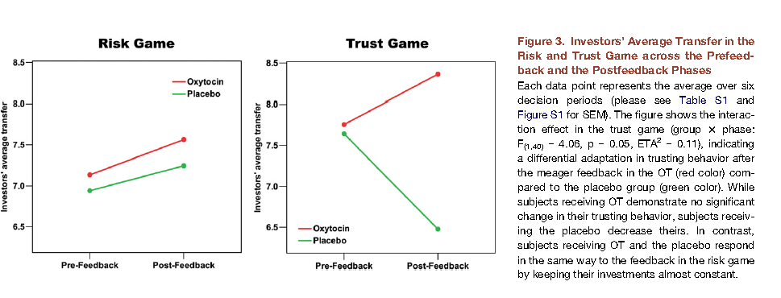

Interação social

Slide 31
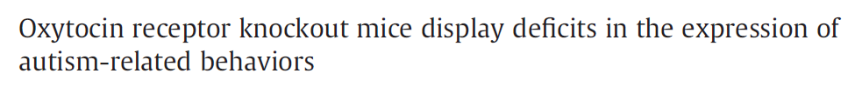
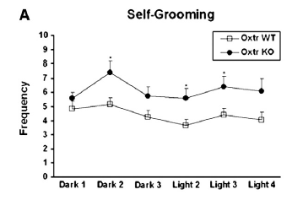


Slide 32
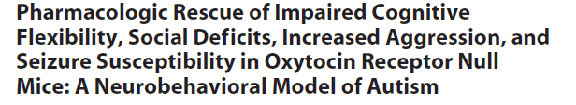
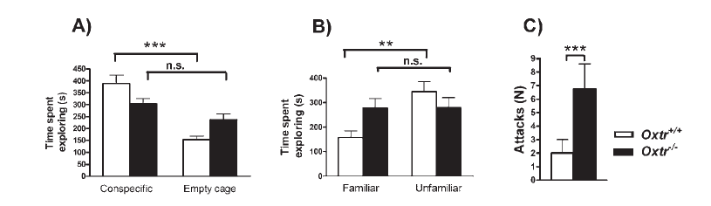
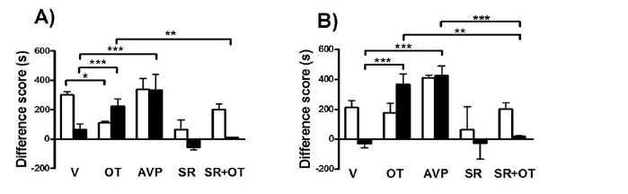

Slide 33
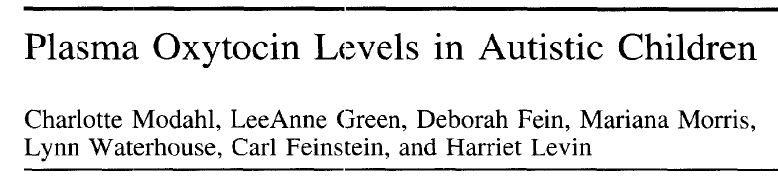
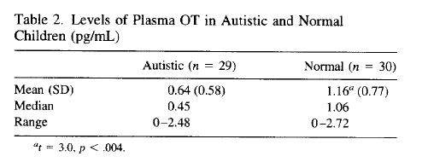

Slide 34
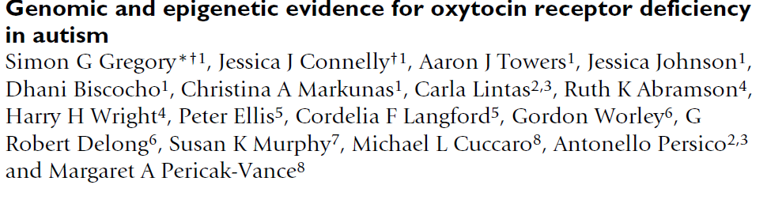
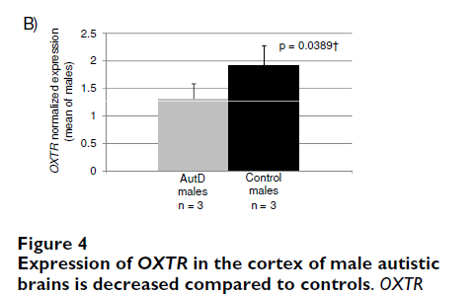

Slide 35
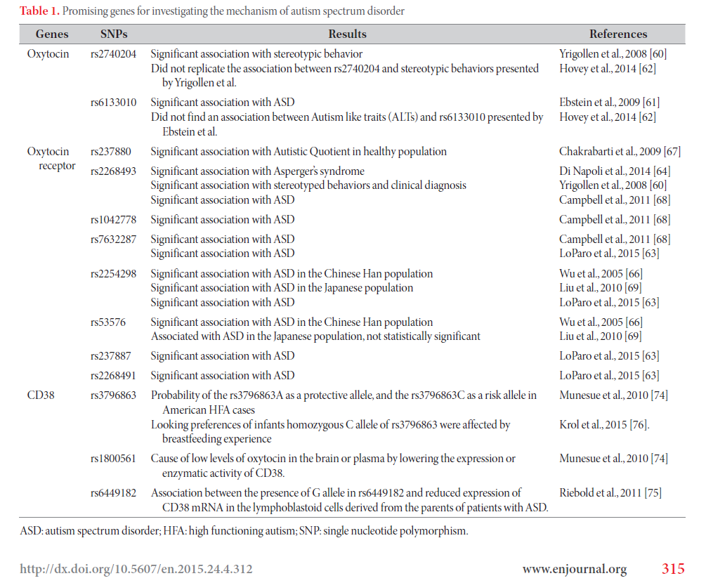
SNP em OTR

Slide 36
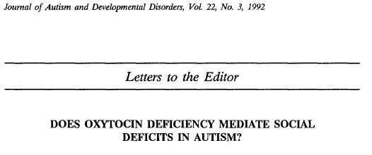
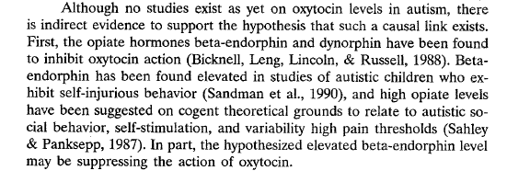
Notes:
found significantly lower levels of plasma
oxytocin in 29 children diagnosed with autism compared with 30
age-matched healthy control children and also found that the
autistic children in their study did not evidence the normal
developmental increase in oxytocin blood levels that was characteristic
of the healthy control children. These researchers also
found a significant correlation between oxytocin levels and
social impairment in a subgroup of their sample identified as
severely affected (i.e., “aloof”).

Slide 37
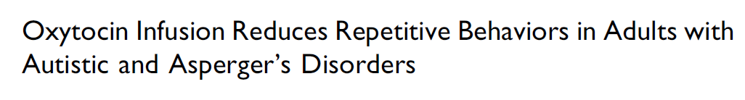
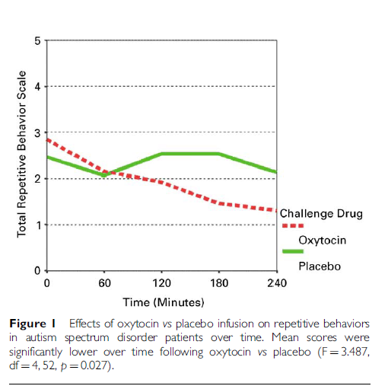


Slide 38
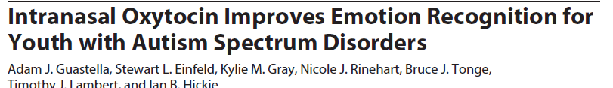
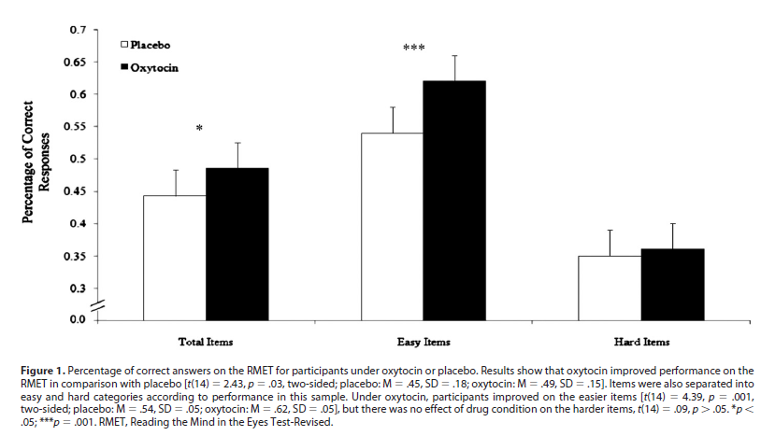

Slide 39
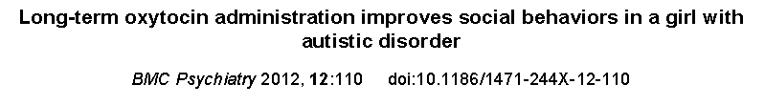
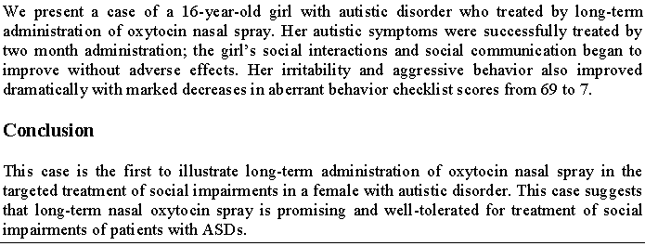

Slide 40
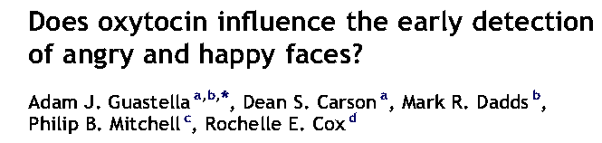




Slide 41


Receptores para ocitocina
Notes:
There is a high degree of preservation of the neuropeptide system across mammalian evolution and the heritability of social behaviour in humans91,92, including autistic traits93, is well known. Hence, variation in genes that encode neuropeptides may shed light on individual differences in social behaviour and heritable disorders, such as ASD, that are characterized by impaired social behaviour. Although studies into the effect of variation in the genes encoding OXT and AVP on social behaviour have been largely uninformative94, a substantial body of evidence now implicates the genes that encode their receptors. A role for OXT in genetic risk for ASD is supported by linkage data102 and disease association with common variants in OXTR94,103–107. Two single nucleotide polymorphisms (SNPs) in the third intron of OXTR have emerged as particularly promising candidates in the recent ASD literature: rs53576 (G to A) and rs2254298 (G to A) (FIG. 2). In several studies, these polymorphisms were overtransmitted in families to offspring with ASD105, and formed a central component in ASD-related haplotypes105,106

Slide 42




Notes:
Regarding OXTR, a recent study found that the rs53576 genotype was associated with morphometric alterations of the hypothalamus and amygdala125 (FIG. 3b). The risk allele-load dependent decrease in hypothalamic volume predicted reduced reward dependence in males. Moreover, the correlation between grey matter volume of the hypothalamus and that of the dorsal cingulate gyrus and amygdala was greater in OXTR risk allele carriers. In two other studies, the rs2254298A OXTR risk alleles were associated with larger amygdala volume143,144,

Slide 43
Ocitocina no desenvolvimento:
Estudos animais
Manipulação de ratos da pradaria neonatos aumenta o comportamento aloparental
Modula a expressão dos OTRs
Infusão de OT altera o comportamento monogâmico das fêmeas, mas não de machos.
Aumenta comportamento agressivo
Aumenta a metilação do DNA do OTR.

Slide 44
Estudos em humanos
Vítimas de abuso na infância apresentam menos ocitocina no líquido cérebro espinal.
Níveis plasmáticos de ocitocina de mães de autistas são significativamente mais baixos

Slide 45
Uso de OT para indução de parto e ASD
Infusão de OT chega ao cérebro fetal
OT diminui a expressão de OTR em cultura de células humanas
Maior incidência de ASD em crianças cujas mães receberam OT no parto ( Gregory e cols., 2013)

Slide 46
Uso crônico de OT: estudos em animais
Dessensibilização de OTR
Redução no RNAm para OTR
Mudanças comportamentais importantes:
  Redução no comportamento de preferência sexual
  Aumento no comportamento agressivo

Slide 47
Clinical trials
http://clinicaltrials.gov/ct2/results?term=oxytocin

Slide 48
Conclusões
Ocitocina participa do comportamento parental e aloparental
Ocitocina regula a interação social
Ocitocina modula o sistema ocitocinérgico

Slide 49
Obrigada

