Slide 1



GNSS-Free Geo-Referencing System Using Multiple LEO CubeSat Formation
Sergio Vicente Denser Pamboukian #*
Pierre Kaufmann #**
Rodolpho Vilhena de Moraes ◊
Pedro Levit Kaufmann ◊
Partners
# Escola de Engenharia, CRAAM, Universidade Presbiteriana Mackenzie, Brasil
* Escola de Engenharia, Laboratório de Geotecnologias, Universidade Presbiteriana Mackenzie, Brasil
** Centro de Componentes Semicondutores, Universidade Estadual de Campinas, Brasil
◊ Universidade Federal do Estado de São Paulo, Brasil

Slide 2
NEW GNSS-FREE GEO-REFERENCING SYSTEM
Current space geo-positioning techniques are based on Global Navigation Satellite Systems (GNSS).
They include the first systems based on ranging and Doppler effect of radio transmitters at low orbit satellites, used until today, and the global positioning systems, based on a constellation of slow moving high altitude satellites such as GPS and equivalents.
An alternate GNSS-free system has been proposed. The concept might be viewed as an “inverted GPS”, using four ground-based reference stations and a number of repeaters in space.
This system has various strategic and economic applications in remote clock synchronism, navigation and target geo-positioning. It may be used as a backup to GNSS location systems in critical applications, or when such systems are not available.

Slide 3
EARLIER CONCEPT OF “INVERTED GPS” WITH 3 BASES
1. Coded time signals transmitted by one fixed base
2. Time comparison at the fixed bases and at target
3. Repeater’s position is determined
Repeater
4. Target position determined with 4 positions of the repeater
or four repeaters in the sky
R
Large Sources of Errors Cannot be Corrected
(Unknowns)
transit time on the repeater
transmission path delays on distinct segments
Target
P
B
C
Reference bases on the ground with well-known geodetic positions
A
Notes:
3

Slide 4
NEW SYSTEM WITH FOUR GROUND-BASED REFERENCES
R
•
•
B
P
•
C
•
A
•
D
Patente depositada no Brasil (INPI), e internacional (PCT) 2012
Cartas-Patente obtidas até 2015: China. México, Colômbia

Slide 5
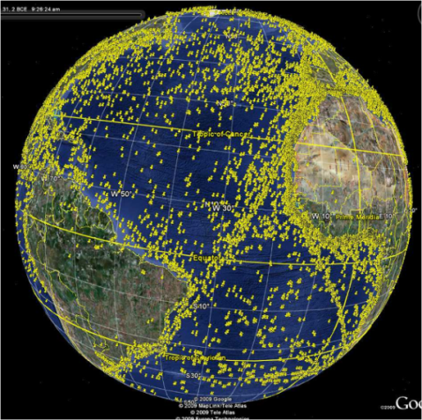
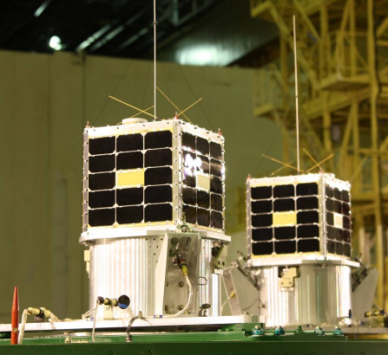
CubeSats are Ideal Transponder Carriers for the New System Applications
In Geo-Referencing
Nanosat:
Power: 20W
Weight: 13kg
Lifetime: 10 years
Thousands users / platforms by orbit
SpaceQuest

Slide 6
SCHEMATIC DIAGRAM OF THE SYSTEM WITH FOUR REPEATERS
The system:
four reference bases on the ground (A, B, C and D), with well-known geodetic positions, carrying synchronized clocks;
a target on the ground (P) or above, with unknown position, carrying synchronized clock;
four repeaters in space (R1, R2, R3 and R4), with unknown positions, carrying synchronized clocks.

Slide 7
SCHEMATIC DIAGRAM OF THE SYSTEM WITH FOUR REPEATERS
A coded time signal is:
transmitted from base A,
retransmitted by the transponders in the sky (R1,R2,R3,R4)
and received by the four reference bases (A,B,C,D) and the target (P), producing five ranging measurements for each satellite.

Slide 8
SCHEMATIC DIAGRAM OF THE SYSTEM WITH FOUR REPEATERS
The clock time differences measured at the bases and the target are forwarded by any means to a processing center, which may be at base A.

Slide 9
SCHEMATIC DIAGRAM OF THE SYSTEM WITH FOUR REPEATERS
The measurements are corrected for time delays in every time coded retransmission caused by three main sources:
the transit time at the transponders,
the path delays,
and delays at the ground-based transmitter and receivers antennas, cables and electronics.

Slide 10
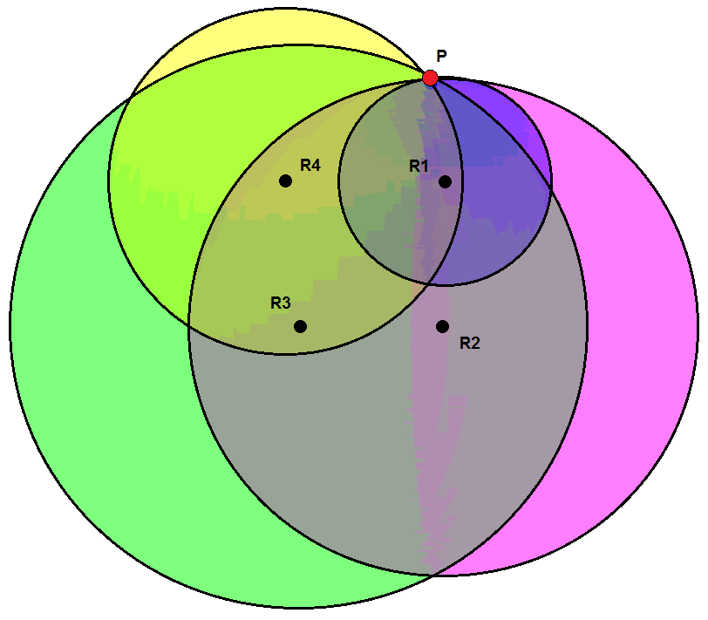
TARGET/REPEATER POSITION DETERMINATION
A target (P) position coordinates can be determined at the interception of four spheres centered at the four repeaters (R1,R2,R3,R4), with radius equal to the distance of the repeater to the target, obtained using propagation times.
The repeaters’ positions can be determined similarly using reference bases on the ground.

Slide 11
ALGORITHM AND SIMULATIONS
The method to determine the time delays at the repeater and on the respective propagation paths compares the positions of the repeater referred to at least two groups of three reference bases, which generates 3 spheres and uses the Earth surface as the fourth sphere.
For a given single time-coded transmitted signal, the calculations of the repeater’s position coordinates are performed for different values assigned to the delays for each set of three reference bases on the ground (ABC, ACD and ABD).

Slide 12
ALGORITHM AND SIMULATIONS
Calculations are done using a known algorithm for every set of three reference bases on the ground.
The discrepancy between the repeater’s positions caused by the transit time value can be given by the following expression:
f(δ_{R}) = |[x_{R}(δ_{R}) , y_{R}(δ_{R}) , z_{R}(δ_{R})] - [x’_{R}(δ_{R}) , y_{R}’(δ_{R}) , z_{R}’(δ_{R})]|² =
= [x_{R}(δ_{R}) - x_{R}’(δ_{R})]² + [y_{R}(δ_{R}) - y_{R}’(δ_{R})]² +[z_{R}(δ_{R})-z_{R}’(δ_{R})]²
The closest value found for δR for every time signal interaction at the repeater corresponds to the minimum value obtained for f(δR) with varying values of δR.
Since the repeater’s position in the sky is not known in advance, the time variations at the repeater and the path delays are, in practice, determined simultaneously.

Slide 13
ALGORITHM AND SIMULATIONS
Since the repeaters’ coordinates are known, the other determinations and applications become straightforward.
It is demonstrated by simulations, based on the system performance algorithms, that with a formation of at least four repeaters, the position of a remote target is determined for a single coded time signal transmission.
A formation of multiple CubeSats in low earth orbits (LEO) is particularly suitable to accomplish the new geo-referencing system.

Slide 14
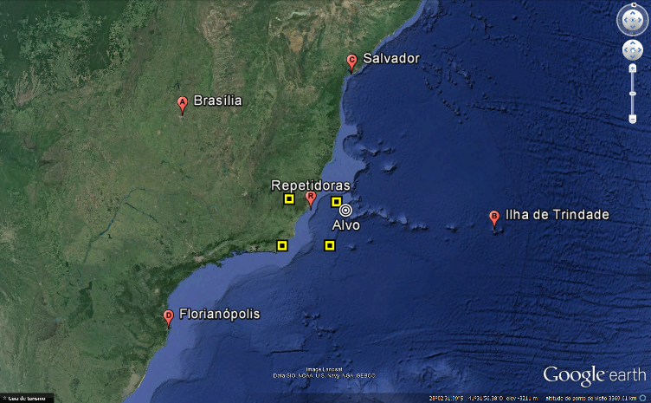
SYSTEM GEOMETRY USED FOR SIMULATIONS
Ground reference bases are on continental Brazil and one at Trindade island, target at an arbitrary position, four repeaters carried by low orbit (500 km) CubeSats.

Slide 15
RESULTS
Simulations assuming mean TEC (Total Electron Content) = 10¹⁷ e/m² for the band of 2000 MHz. Satellites placed at altitude of 500 km displaced by about 2° (i.e. about 240 km) from each other. Assumed overall system random clock uncertainty of 3.3 nanoseconds.
Typical uncertainties of:
  5-80 m for target coordinates;
  20-100 m for repeaters (satellites) positions;
  1-90 ns for remote clock synchronism.

Slide 16
RESULTS
The new geo-referencing system performance using four satellite repeaters is highly encouraging, even assuming gross approximations.
Delays due to signal transit times at the transponders and to radio propagation are efficiently minimized by the algorithms utilized.
The obtained accuracies remain about the same for TEC changes within one order of magnitude.

Slide 17
CONCLUDING REMARKS
System improvements are currently investigated, including enhancing accuracies by statistical treatment, the development of new mathematical solutions, and the use of two radio frequencies links to allow actual TEC estimates.
CubeSats are ideal transponder carriers.
  There are no critical on-board requirements.
  The power requirements for the transponder are of the order of 20W, which are attainable by CubeSats.
The implementation of one operational pilot system using CubeSats as the repeaters’ carriers is being considered.

Slide 18
Prof. Pierre Kaufmann pierrekau@gmail.com
Phone: 55-11-2114-8331
Prof. Sergio V. D. Pamboukian sergio.pamboukian@gmail.com
Phone: 55-11-2114-8953

Slide 19
EQUATIONS
AR(δ_{R}, Δ_{pdAR}) = ( Δt_{A} - δ_{At} - δ_{Ar} - δ_{R} ) (c/2) - Δ_{pdAR}
BR(δ_{R}, Δ_{pdAR}, Δ_{pdBR}) = ( Δt_{B} - δ_{At} - δ_{Br} - δ_{R} ) c - Δ_{pdBR} - Δ_{pdAR} - AR(δ_{R})
CR(δ_{R}, Δ_{pdAR}, Δ_{pdCR} ) = ( Δt_{C} - δ_{At} - δ_{Cr} - δ_{R} ) c - Δ_{pdCR} - Δ_{pdAR} - AR(δ_{R})
DR(δ_{R}, Δ_{pdAR}, Δ_{pdDR}) = ( Δt_{D} - δ_{At} - δ_{Dr} - δ_{R} ) c - Δ_{pdDR} - Δ_{pdAR} - AR(δ_{R})
PR(δ_{R}, Δ_{pdAR}, Δ_{pdPR}) = ( Δt_{P} - δ_{At} - δ_{Pr} - δ_{R} ) c - Δ_{pdPR} - Δ_{pdAR} - AR(δ_{R})
AR, BR, CR, DR, and PR are the distances of bases A, B, C, D and of the target P to the repeater R, respectively, expressed as a function of time variations caused by the signal transit at the repeater (δR), and corrected for the respective propagation path delays (Δ_{pd)}.

Slide 20
EQUATIONS
AR(δ_{R}, Δ_{pdAR}) = ( Δt_{A} - δ_{At} - δ_{Ar} - δ_{R} ) (c/2) - Δ_{pdAR}
BR(δ_{R}, Δ_{pdAR}, Δ_{pdBR}) = ( Δt_{B} - δ_{At} - δ_{Br} - δ_{R} ) c - Δ_{pdBR} - Δ_{pdAR} - AR(δ_{R})
CR(δ_{R}, Δ_{pdAR}, Δ_{pdCR} ) = ( Δt_{C} - δ_{At} - δ_{Cr} - δ_{R} ) c - Δ_{pdCR} - Δ_{pdAR} - AR(δ_{R})
DR(δ_{R}, Δ_{pdAR}, Δ_{pdDR}) = ( Δt_{D} - δ_{At} - δ_{Dr} - δ_{R} ) c - Δ_{pdDR} - Δ_{pdAR} - AR(δ_{R})
PR(δ_{R}, Δ_{pdAR}, Δ_{pdPR}) = ( Δt_{P} - δ_{At} - δ_{Pr} - δ_{R} ) c - Δ_{pdPR} - Δ_{pdAR} - AR(δ_{R})
Δt_{A}, Δt_{B}, Δt_{C}, Δt_{D}, and Δt_{P} are the time differences effectively measured at bases A, B, C, and D, as well as at the target P, respectively, with respect to their clocks.
δ_{At} is the time variation due to signal transit in circuits and cables when transmitted from base A, previously measured and known.

Slide 21
EQUATIONS
AR(δ_{R}, Δ_{pdAR}) = ( Δt_{A} - δ_{At} - δ_{Ar} - δ_{R} ) (c/2) - Δ_{pdAR}
BR(δ_{R}, Δ_{pdAR}, Δ_{pdBR}) = ( Δt_{B} - δ_{At} - δ_{Br} - δ_{R} ) c - Δ_{pdBR} - Δ_{pdAR} - AR(δ_{R})
CR(δ_{R}, Δ_{pdAR}, Δ_{pdCR} ) = ( Δt_{C} - δ_{At} - δ_{Cr} - δ_{R} ) c - Δ_{pdCR} - Δ_{pdAR} - AR(δ_{R})
DR(δ_{R}, Δ_{pdAR}, Δ_{pdDR}) = ( Δt_{D} - δ_{At} - δ_{Dr} - δ_{R} ) c - Δ_{pdDR} - Δ_{pdAR} - AR(δ_{R})
PR(δ_{R}, Δ_{pdAR}, Δ_{pdPR}) = ( Δt_{P} - δ_{At} - δ_{Pr} - δ_{R} ) c - Δ_{pdPR} - Δ_{pdAR} - AR(δ_{R})
δ_{Ar} , δ_{Br} , δ_{Cr} , δ_{Dr}, and δ_{Pr} are the time variations due to the signal transits on circuits and cables when received at bases A, B, C, D, and P, respectively, previously measured and known.
δ_{R} is the time variation due to the signal transit at the repeater (R) to be determined.
c is the speed in free space of the electromagnetic waves that transport the coded time signal.

Slide 22
EQUATIONS
AR(δ_{R}, Δ_{pdAR}) = ( Δt_{A} - δ_{At} - δ_{Ar} - δ_{R} ) (c/2) - Δ_{pdAR}
BR(δ_{R}, Δ_{pdAR}, Δ_{pdBR}) = ( Δt_{B} - δ_{At} - δ_{Br} - δ_{R} ) c - Δ_{pdBR} - Δ_{pdAR} - AR(δ_{R})
CR(δ_{R}, Δ_{pdAR}, Δ_{pdCR} ) = ( Δt_{C} - δ_{At} - δ_{Cr} - δ_{R} ) c - Δ_{pdCR} - Δ_{pdAR} - AR(δ_{R})
DR(δ_{R}, Δ_{pdAR}, Δ_{pdDR}) = ( Δt_{D} - δ_{At} - δ_{Dr} - δ_{R} ) c - Δ_{pdDR} - Δ_{pdAR} - AR(δ_{R})
PR(δ_{R}, Δ_{pdAR}, Δ_{pdPR}) = ( Δt_{P} - δ_{At} - δ_{Pr} - δ_{R} ) c - Δ_{pdPR} - Δ_{pdAR} - AR(δ_{R})
Δ_{pdAR}, Δ_{pdBR}, Δ_{pdCR}, Δ_{pdDR} and Δ_{pdPR} are the propagation paths delays to be determined in the process.

Slide 23
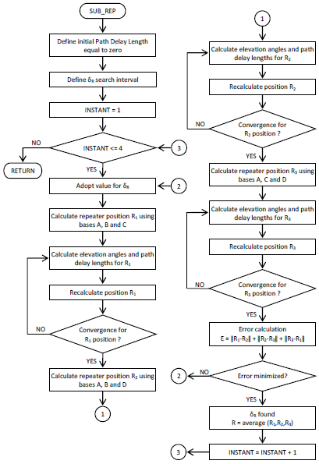
Flow diagram to calculate the transit time at the repeater, the path delays, and the repeater’s position

Slide 24
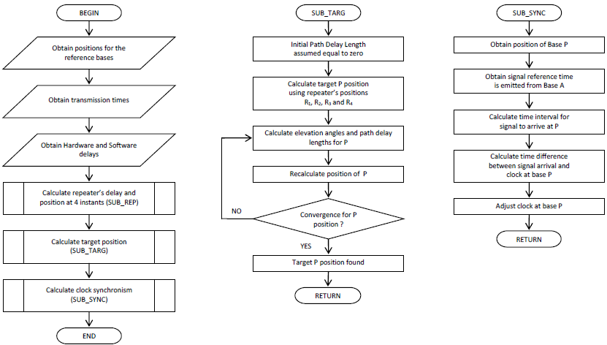
Flow diagrams showing the main routine, the target position calculation, and clock synchronization.

Slide 25
PATH TIME DELAY MODEL USED IN SIMULATIONS
The simulations are performed adopting path time delays δ_{TEC} given by the Total Electron Content (TEC):
δ_{TEC} = S x 1.343 (TEC/f²) x 10⁻⁷
where TEC is the Total Electron Content (e/m²)
f is the transmission frequency (MHz)
S is the slant factor for the respective elevation angles E the repeaters are observed from the bases and target:
S = 1/cos {arcsin [(R/(R+h)) x cos E]}
where R is the Earth radius
h is the ionosphere reference altitude
S equals 1 to 2.5 for elevation angles of 90 to 15 degrees.

